Slide 1
Battle of Neighborhood
By ,
Varsha v

Slide 2
Contents
1. Introduction of use case
1.1 Scenario and Background
1.2 Problem to be resolved
1.3 Interested Audience
2. Data used in use case
2.1 Data of Current Location (current residence place)
2.2 Data required to resolve the problem
2.3 Data sources and data manipulation
2.4 How the data will be used to solve the problem
2.5 Mapping of Data

Slide 3
Contents continued
3. Methodology
3.1 The analysis and the strategy:
3.2 Data Science Methods, machine learning, mapping tools and exploratory data analysis.
3.3 Map of Mangalore with venues near residence place - for reference
3.4 Manhattan neighborhood
4. Results Section
4.1 Map of Manhattan neighborhoods with top 10 clustered venues.
5. Discussion Section
6. Conclusion Section¶

Slide 4
Introduction to use case :
Scenario and Background
I currently live within walking distance to City Centre Mall Mangalore and I enjoy many places in the area, such as various famous cuisine restaurants, cafes, food shops and entertainment.
I have been offered a great opportunity to work for a leader firm in Manhattan, NY. I am very excited and I want to use this opportunity to practice my learnings in Coursera in order to answer relevant questions arisen. The key question is : How can I find a convenient and enjoyable place similar to mine now in Mangalore?
Certainly, I can use available real estate apps and Google but the idea is to use and apply myself the learned tools during the course. In order to make a comparison and evaluation of options in Manhattan NY, I must set some basis, therefore the apartment in Manhattan must meet the following demands:
desired location is near a mall in the Manhattan area and within 1.0 mile (1.6 km) radius top ammenities in the selected neighborhood shall be similar to current residence desirable to have venues such as hotel, clothing Store, theater, bookstore and bakery. As a reference, I have included a map of venues near current residence in Mangalore.

Slide 5
Problem to be resolved
The challenge is to find a suitable apartment for rent in Manhattan NY that complies with the demands on location and venues. The data required to resolve this challenge is described in the following section 2, below.
Interested Audience
I believe this is a relevant challenge with valid questions for anyone moving to other large city in US, EU or Asia. The same methodology can be applied in accordance to demands as applicable. This case is also applicable for anyone interested in exploring starting or locating a new business in any city. Lastly, it can also serve as a good practical exercise to develop Data Science skills.

Slide 6
Data used in usecase
Data of Current Location
I Currently reside in the neighborhood of Ocean Pearl, Mangalore, India. I use Foursquare to identify the venues around the area of residence which are then shown in the Mangalore map shown in methodology and execution in section 3.0 . It serves as a reference for comparison with the desired future location in Manhattan NY
Data Required to resolve the problem
The following data is required to answer the issues of the problem:
List of neighborhoods of Manhattan with their geodata (latitud and longitud) List of hotel, clothing Store, theater, bookstore and bakery in Manhattan with their address location Venues for each Manhattan neighborhood ( than can be clustered)

Slide 7
Data Source
Manhattan neighborhoods csv formed during the course. A csv file was created which will be read in order to create a data frame and its mapping. The csv file 'manhattan_neghbour.csv' will be directly read to the Jupiter Notebook for convenience. The clustering of neighborhoods and mapping will be shown.
How the data will be used to solve the problem
The data will be used as follows:
Use Foursquare and geopy data to map top 10 venues for all Manhattan neighborhoods and clustered in groups ( as per Course LAB)

Slide 8
Mapping of Data
The following maps were created to facilitate the analysis and the choice of the palace to live.
Manhattan map of Neighborhoods Manhattan map of clustered venues and neighborhoods
This section represents the main component of the report where the data is gathered, prepared for analysis. The tools described are used here and the Notebook cells indicates the execution of steps.

Slide 9
Methodology
This section represents the main component of the report where the data is gathered, prepared for analysis. The tools described are used here and the Notebook cells indicates the execution of steps.
The analysis and the strategy:
The strategy is based on mapping the above described data in section 2.0, in order to facilitate the choice of a candidate places for accommodation. The choice is made based on the demands imposed : similar venues to Mangalore, India. This visual approach and maps with popups labels allow quick identification of location, thus making the selection very easy.
The processing of these DATA and its mapping will allow to answer the key questions to make a decision:
What are the venues of the best place to live? How venues distribute among Manhattan neighborhoods ?
Methodology followed - Data Science Methods, machine learing, mapping tools and exploratory data analysis
Mangalore Map - Current residence and venues in neighborhood for comparison to future Manhattan place

Slide 10
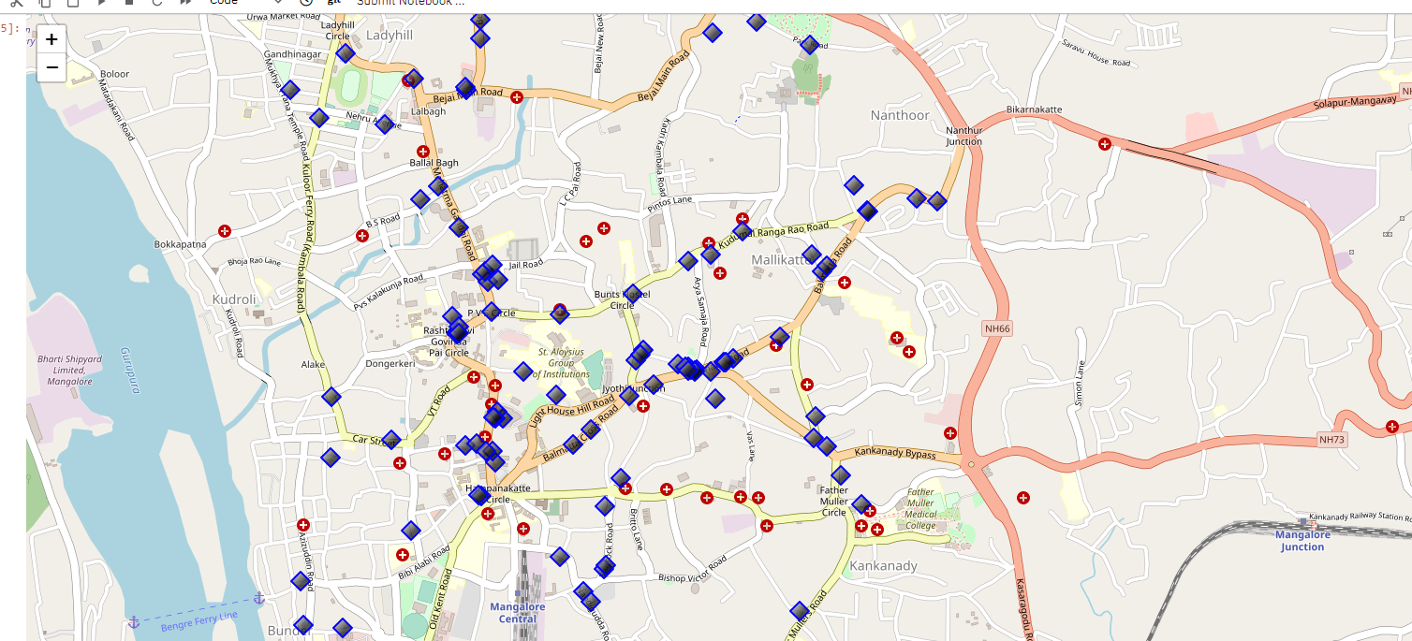
Map of Mangalore with venues near residence place - for reference

Slide 11
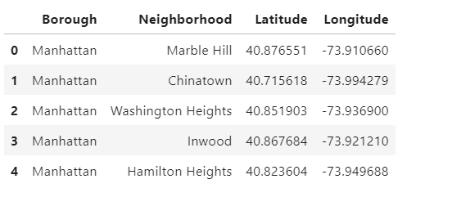
Manhattan neighborhood
Cluster neighborhood data was produced with Foursquare during course lab work. A csv file was produced containing the neighborhoods around the 40 Boroughs. Now, the csv file is just read for convenience and consolidation of report.
Grouped rows by neighborhood and by taking the mean of the frequency of occurrence of each category
Group all the rows based on the neighborhood for better understanding of the actual values
Created a new data frame and displaying the top 10 venues for each Neighborhood
Perform Clustering on the obtained data frame

Slide 12
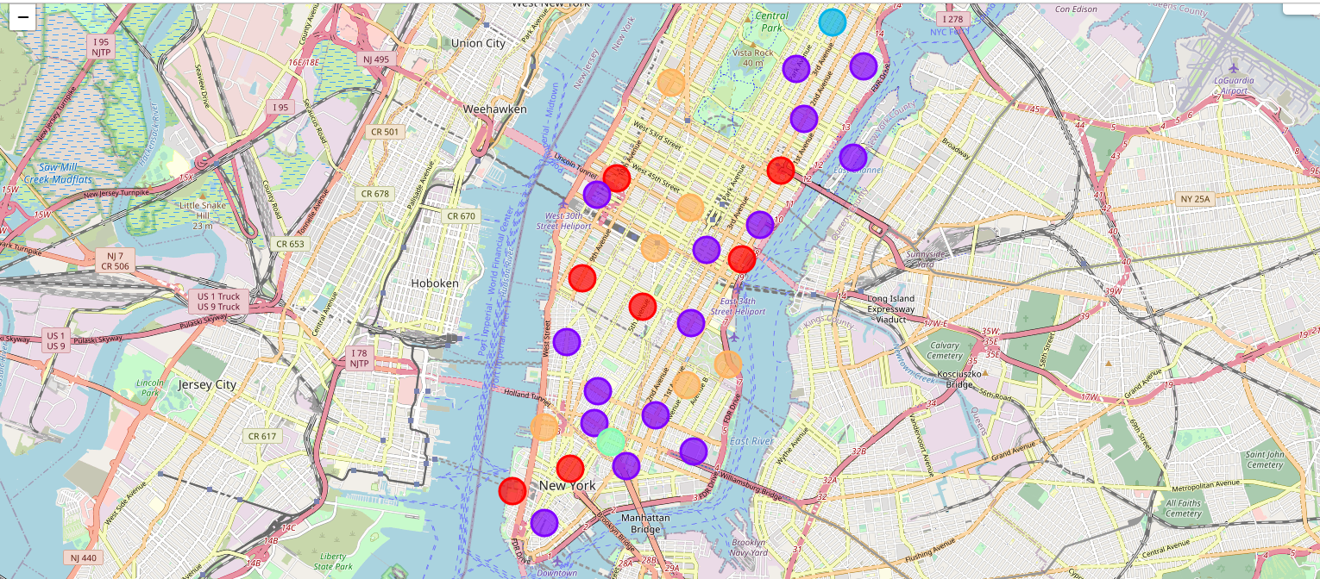
Results

Slide 13
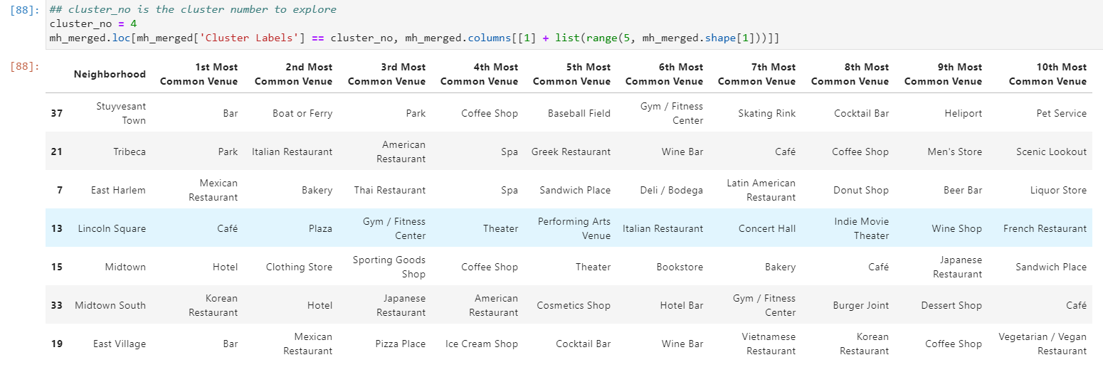
Venue Selection

Slide 14
Discussion
Apartment Selection
The map above helped me to explore all possibilities since the popups provide the information needed for a good decision
Selecting the apartment in a location similar to the current one in Mangalore.

Slide 15
Conclusion
After examining the various, I have chosen the locations that meets the requirements which will assess to make a choice.
Midtown Neighborhood, Cluster 4: Midtown District is having Hotel, Clothing Store, Theater, Bookstore, Bakery similar to Mangalore residence.
Midtown District is having Hotel, Clothing Store, Theater, Bookstore, Bakery is my preferable choice for a future residence.
Based on current residence at Mangalore, I feel that Cluster 4 type of venues is a closer resemblance to my current place. Which means that Financial District is a better choice since it has Hotel, Clothing Store, Theater, Bookstore and is worth the convenience it provides.

Slide 16
THANK YOU

